Slide 1
La meets ML

Slide 2
Why one has to solve large sparse systems
physics
Electrical engineering
…
Pretty pictures, the more dramatic the better
such as the voltage across a circuit component
the physical forces between two points in a mechanical structure
Commonality-> can be represented with a sparse matrix
Solving those can tell us something about how the real world behaves
Google’s page rank algorithm, for example, requires the computation of an eigenvector for a matrix with as many rows and columns as there are pages on the web.
Portfolio management
for tracking orbital debris

Slide 4
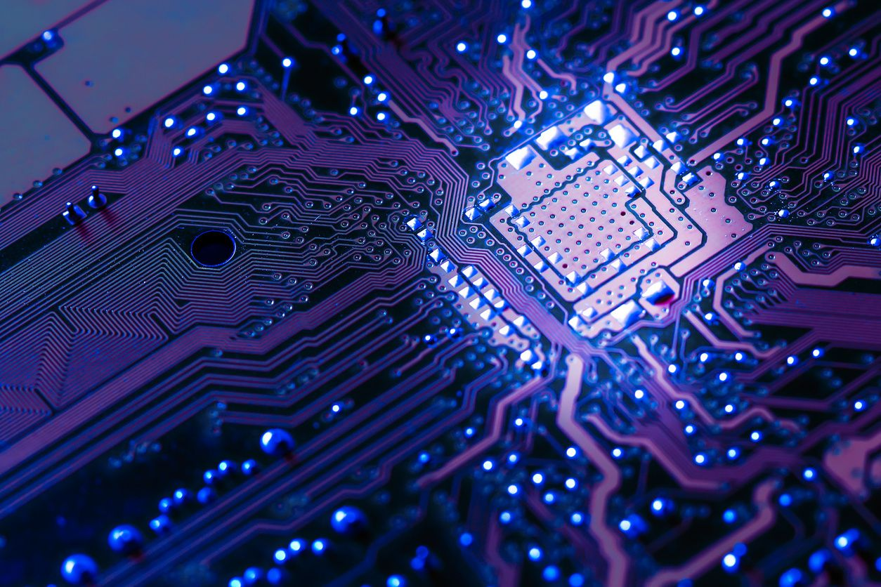

Slide 5
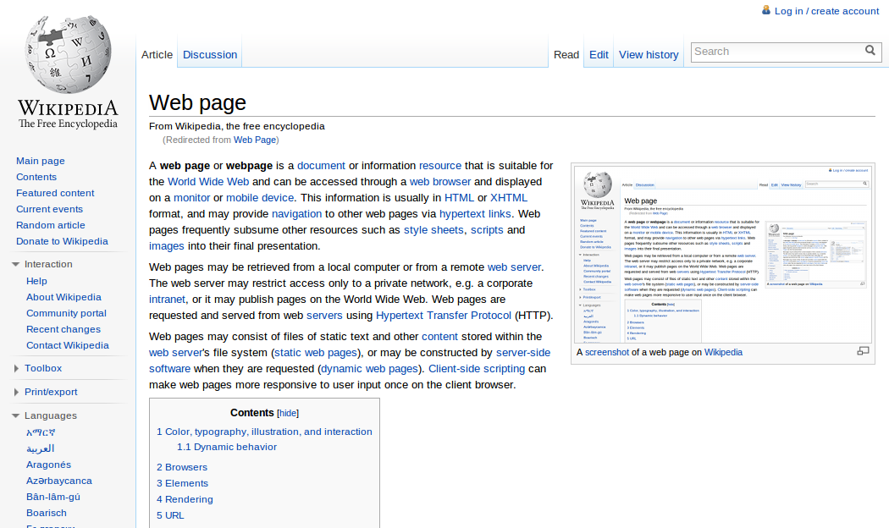

Slide 6


Slide 7
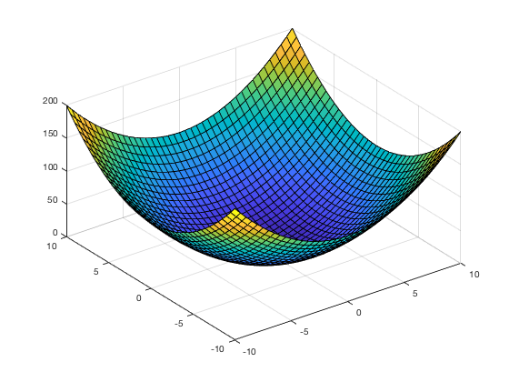

Slide 8
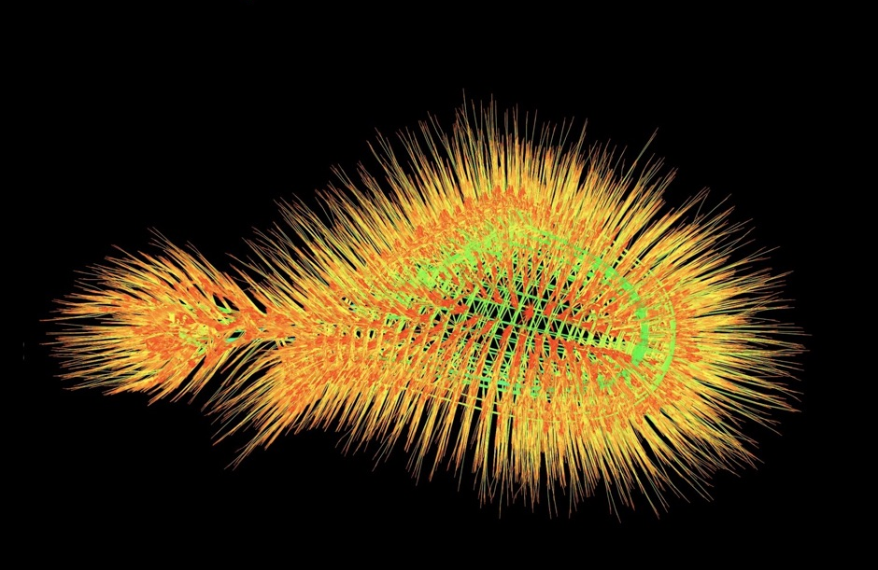

Slide 9
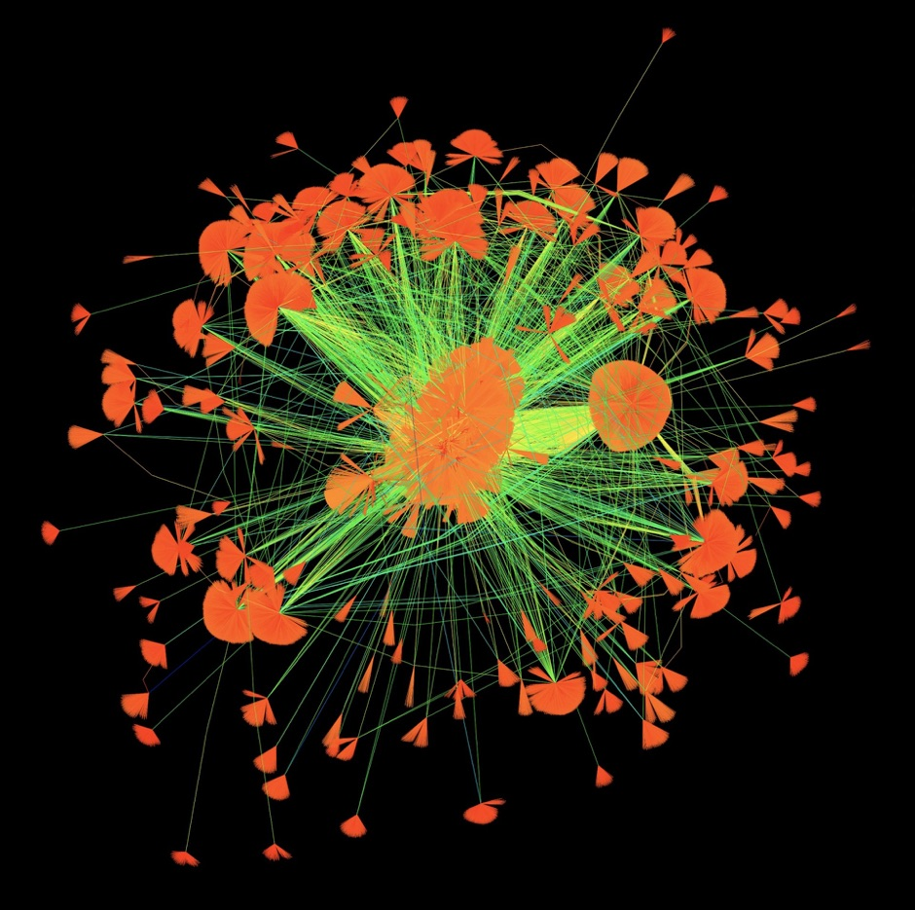

Slide 10
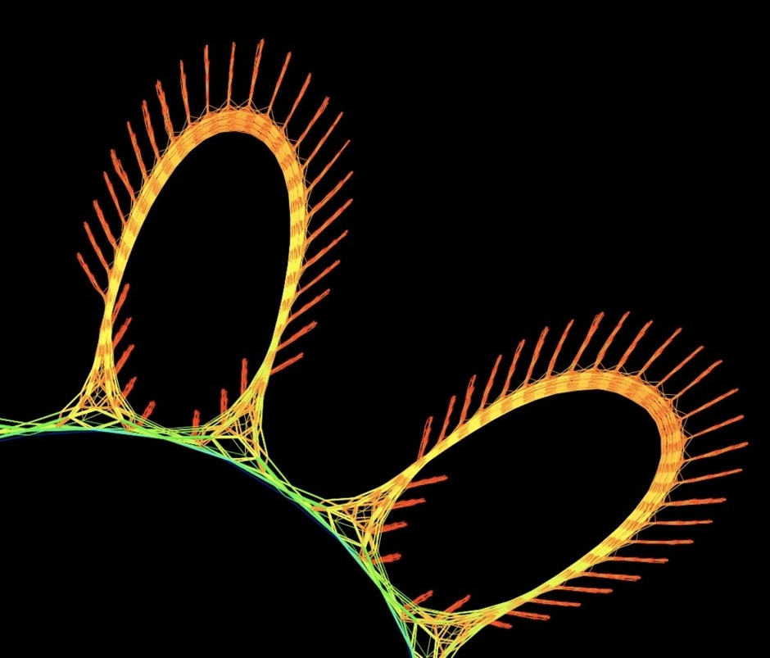

Slide 11
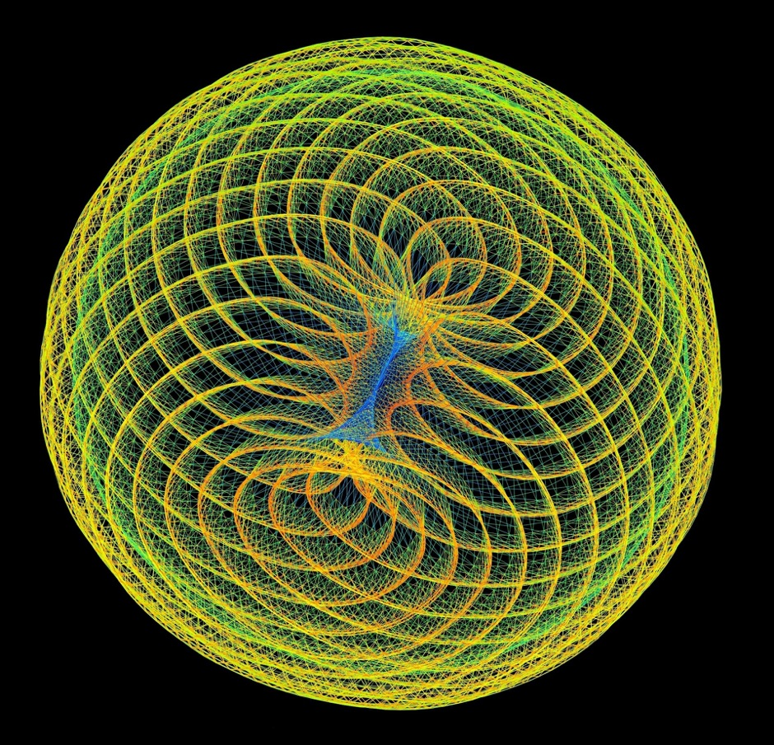

Slide 12
Daisy Chain: Financial Portfolio Optimization (2009). Optimizing a financial portfolio leads to a graph with many branches, each depicting a possible future economic scenario. Which path will your portfolio take?
Web Poppies (2009) You like a web page and I like it too. 512 people like 394,792 web pages, do you like them too
reddish-orange frequency-domain circuit simulation matrix constructed via the harmonic-balance method
Convex Quadratic Programming (2009)
Web Poppies (2009) You like a web page and I like it too. 512 people like 394,792 web pages, do you like them too?
One Fish, Two Fish (2009) A blue constraint matrix from a linear programming problem meets a reddish-orange frequency-domain circuit simulation matrix constructed via the harmonic-balance method, swimming alongside.

Slide 13
Explain how they get solved iterativly
Different solvers with different properties
Not clear which one will solve a given matrix the fastest
Show diagram of times

Slide 14
.. Our approach solves this issue
Explain or product
The 4 modules
Overview(picture)

Slide 15
collector

Slide 16
´labeling module

Slide 17
Traning module

Slide 18
Classifier

Slide 19
Now we can get into details if we have time
Output service
Usage of our product
Statistics(loc,coverage,accuracy of nn…)

Slide 20
reflection
Challenges
How we solved them
How much of the mandetory/optional requirements we achieved

Slide 21
outlook
What we could add

